Slide 1
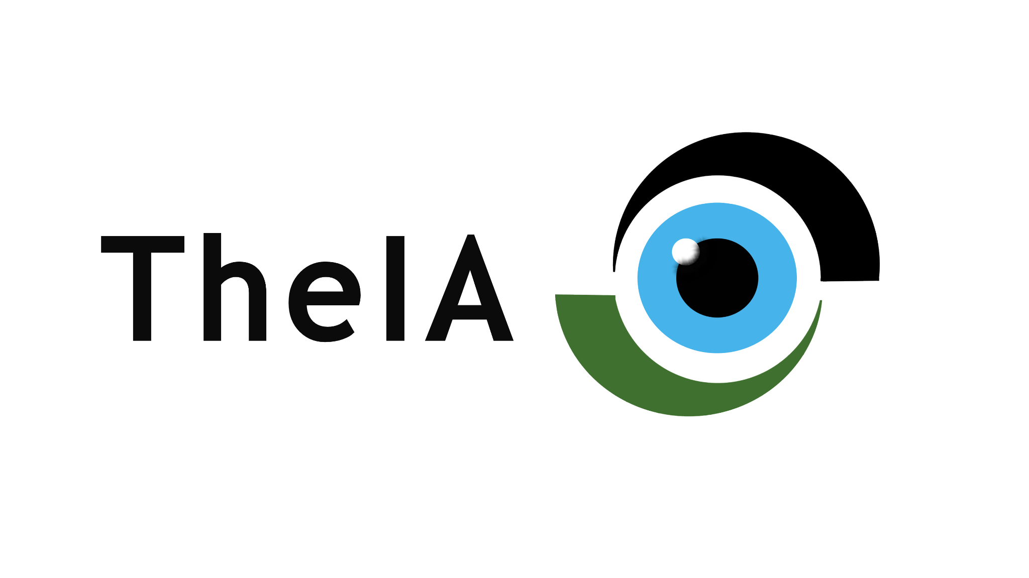
SAMSUNG INNOVATION CAMPUS UNIPV 2021-22
PRESENTED BY GROUP B

Slide 2
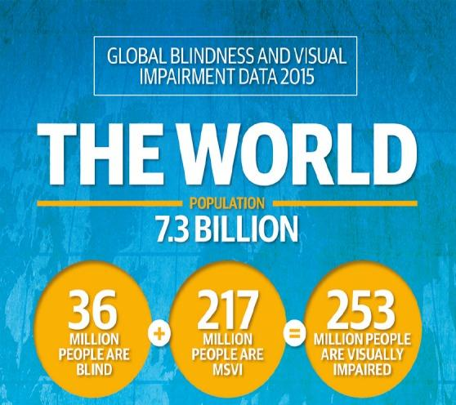

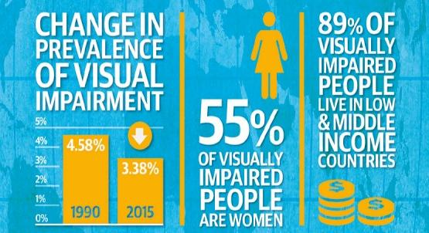
PROBLEM STATEMENT
According to data from ncbi.nlm.nih.gov

Slide 3
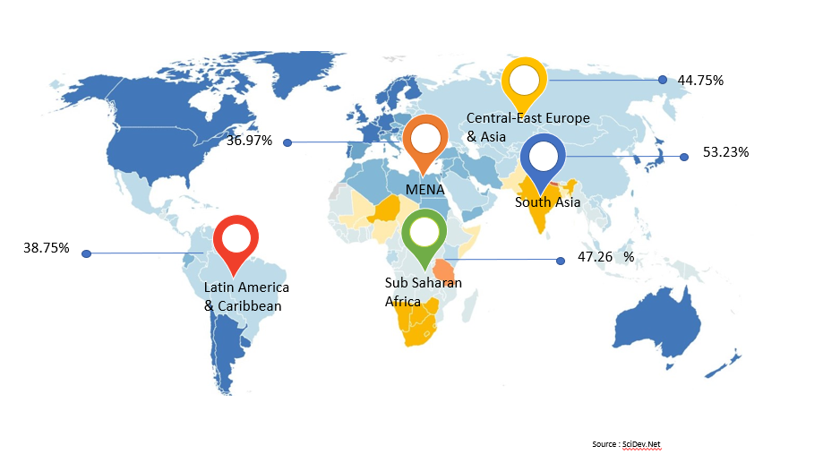
VISION IMPAIRMENT BY REGION

Slide 4
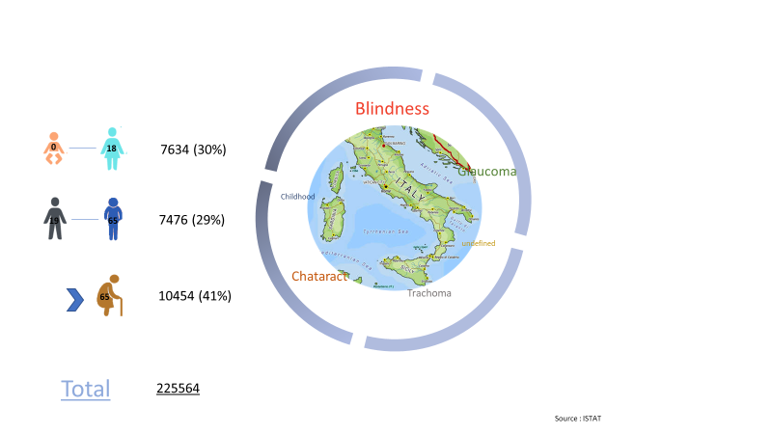
VISUAL IMPAIRMENT IN ITALY

Slide 5

OUR POTENTIAL CUSTOMERS
Prototype
Refine
In 2015, there were an estimated 253 million people with visual impairment worldwide.
Of these, 36 million were blind and a further 217 million had moderate to severe visual impairment (MSVI).
Even if we get to empower a 1% of the blind population we cover 3.6 million people!
*as per data by ncbi.nlm.nih.gov
Get feedback

Slide 6
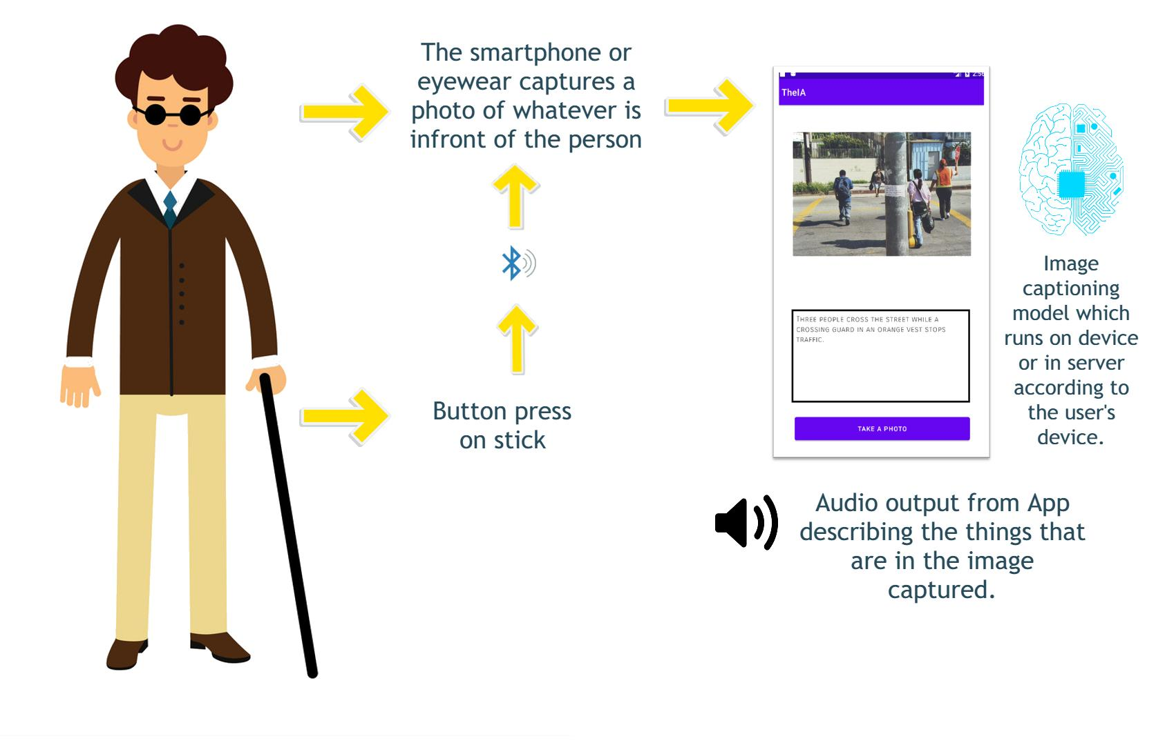
OUR IDEA

Slide 7
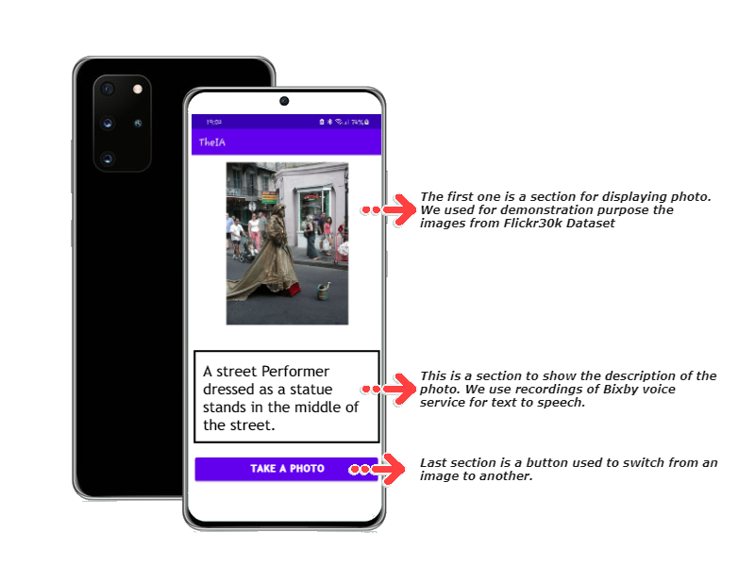
Prototype App

Slide 8
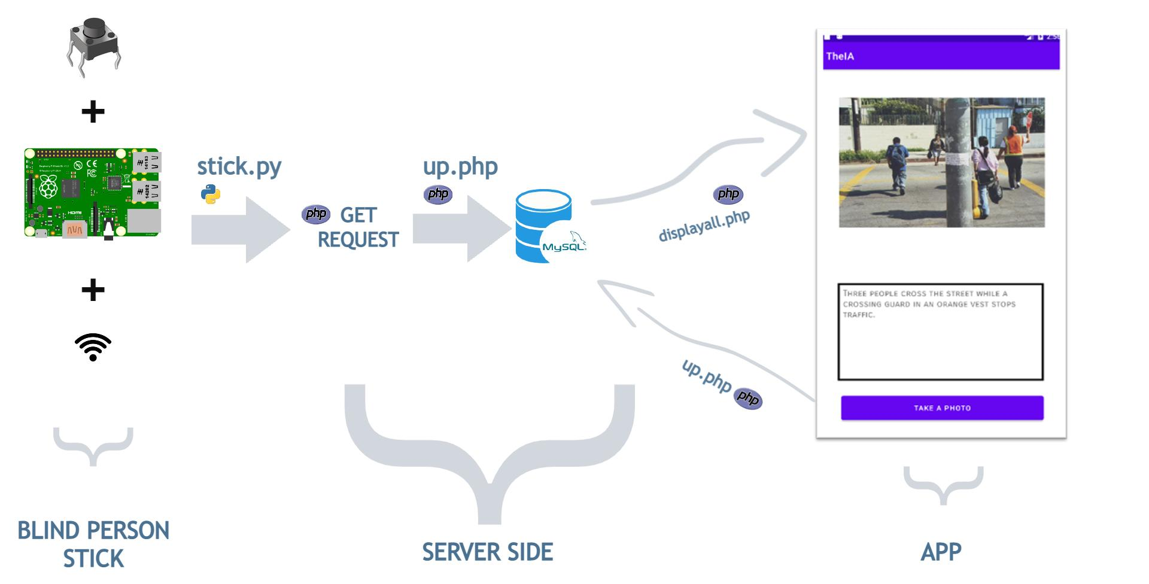
PROTOTYPE

Slide 9





Business Flow
Partnerships⁽²⁾
Value Propositions⁽¹⁾
Customers⁽²⁾
Activities⁽¹⁾
Resources⁽³⁾
Notes:
i would like a graph but idk

Slide 10
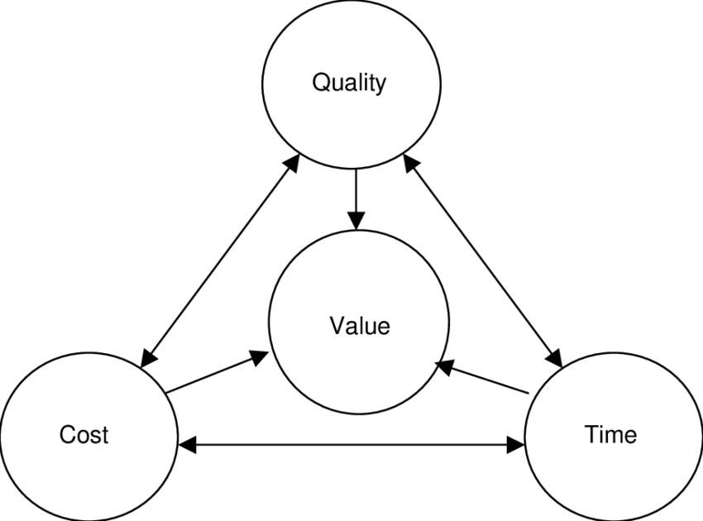


Is it affordable and profitable?
High quality (€€€) -
Financing grants =
Sustainable cost⁽²⁾
Individual customer purchases +
Contracts with resellers =
Revenues⁽²⁾
Notes:
i would like a graph but idk

Slide 11
Credits
⁽¹⁾Designed by ibrandify
⁽²⁾Designed by rawpixel.com
⁽³⁾Designed by geotatah from Flaticon
Notes:
i would like a graph but idk

Slide 12

Our Team
Anton Giulio Cancellara
Nishan Chettri
Lorenzo Marti
Vina Panduwinata
Roberto Zappa

Slide 13
ANY QUESTIONS?

Slide 14
Designed for:
Designed by:
Date:
Version:
Business Model Canvas
TheIA
Lorenzo Marti
21/01/2022
1.0
Key Partners
Key Activities
Value Propositions
Channels
Customer Segments
Authorized resellers
Logistics company
Government agencies
Visually impaired people foundations
Certifying agencies
Suppliers (electronics, optics)
Cloud computing service
Radio and web-based media companies for advertisement purposes.
Production of AI and IoT based devices for visually impaired people assistance
Development and maintenance of a webstore for the sale of our products and for customer support
Negotiation with the government and patient organizations for co-financing solutions and optimal product placement
Constant follow ups of certification processes for quality and legal compliance of our products
Continuous interaction with customers for feedback collection aimed to a better product development and to the improvement of brand awareness
Visually impaired people constantly helped in the recognition of objects in everyday activities
Very original, AI based pair of glasses with captivating design
Practical, very accessible and minimal device interface to help every visually impaired customer, regardless of her/his IT knowledge
Variety of product specifications with respect to the characteristics of the eye disease affecting the user
Different services depending on user’s hardware capabilities
Possible convenient prices for the end customer through expected co-financing options granted by government agencies
Valuable agreements with sales partners to maximize the outreach of our products
Radio broadcast as the most economical advertisement solution
Web streaming and social media platforms advertisement as the most effective solutions
Informative website for product and company details
Sponsorships of visually impaired people organizations’ events
Distribution through our webstore and partner stores
Segmented market divided in:
B2C segment
Visually impaired people with minimal IT knowledge
Professionals dedicated to the assistance of blind people
B2B segment
Independent opticians’ shops and pharmacies
Franchises selling glasses for the mass market
Key Resources
Customer Relationships
Strategic patents and certifications as pivotal intellectual resources for the startup
Limited amount of physical assets (manufacturing facilities, offices)
Diversified but limited human and financial resources
Email, telephone and social media personal assistance
User community as both an assistance service and a way to engage with customers
Web surveys for feedback about customer and partner seller satisfaction
Cost Structure
Revenue Streams
Important fixed costs (contracts with key partners, salaries)
Less relevant variable costs (market availability of product components, financial activity)
Highest expenses in supply contracts and advertisement solutions
Focus on high quality implies great expenses for design, production and commercialization of our devices
Periodical revenues from authorized dealer agreements made with partner stores and from cloud services subscriptions required to use the products on middle to low tier user hardware
Non constant volume of revenues from individual customers web purchases (minor income stream)
Feature dependent pricing method: optional addons and customizations increase the total price

